Slide 1
Luxe Hotel Reservation
Fia Valentina Setiono (2120010048)
Gendis Putri Ayu Larasati (2120010054)

Slide 2
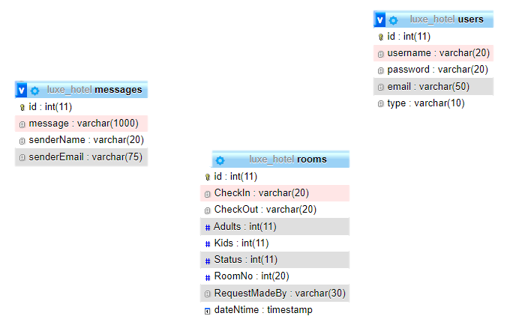
Database Diagram

Slide 3
System Summary
Luxe Hotel is a 4-star hotel that stands majestically in the center of Bogor City. Luxe Hotel Bogor is the second hotel under the Moon Light Hotel Group and has been open since February 18, 2018.
In this project, users can search for all information, such as hotel descriptions, and the room types. this is why a good hotel reservation system is needed to make this task as easy as possible. This paper shows how the noted complicated human task can be solved by using a database Management System together with scripting and programming languages like HTML respectively as the key tools in the development of a Luxe Hotel System.
Luxe Hotel

Slide 4
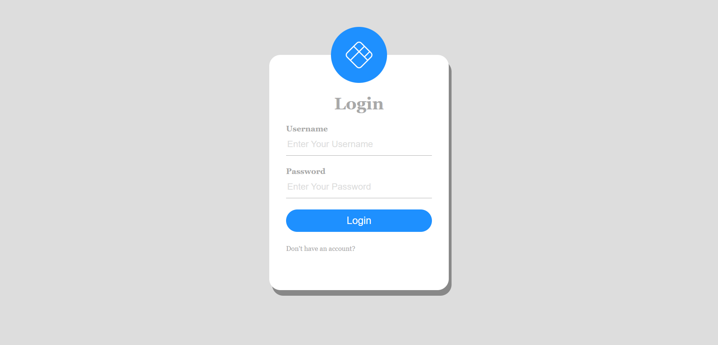
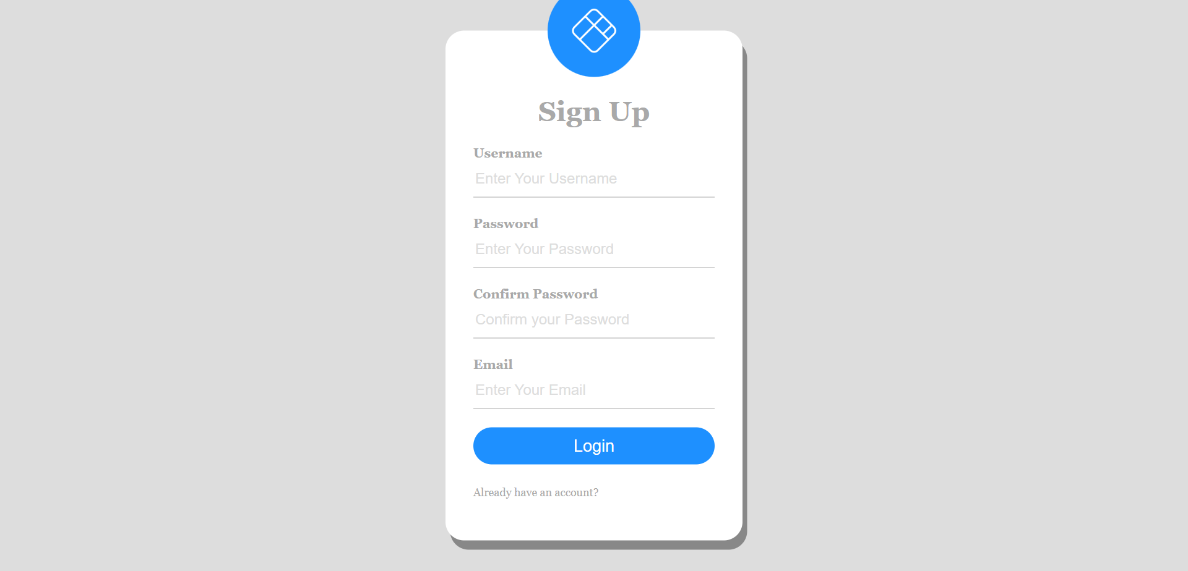
JSP PAGES
Login
In this form, we can login as a user or as employee
Sign Up
In this form, user can make a account for register
Home
Backgrounds
Banners
Planners
Homework
Tests

Slide 5
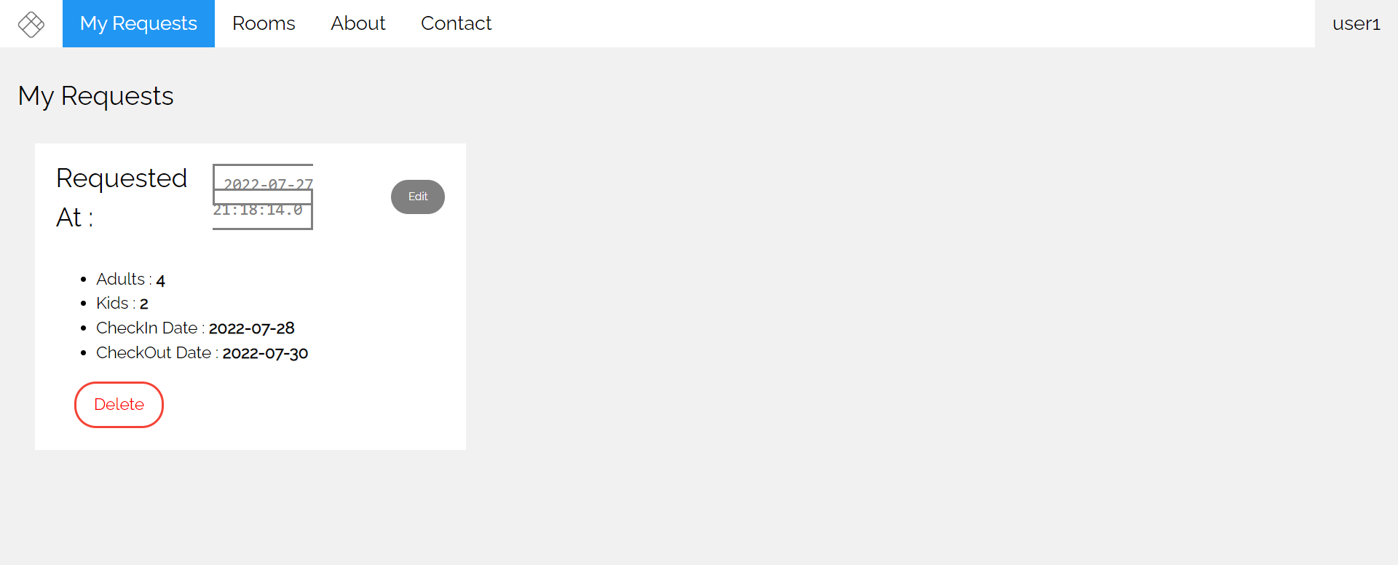
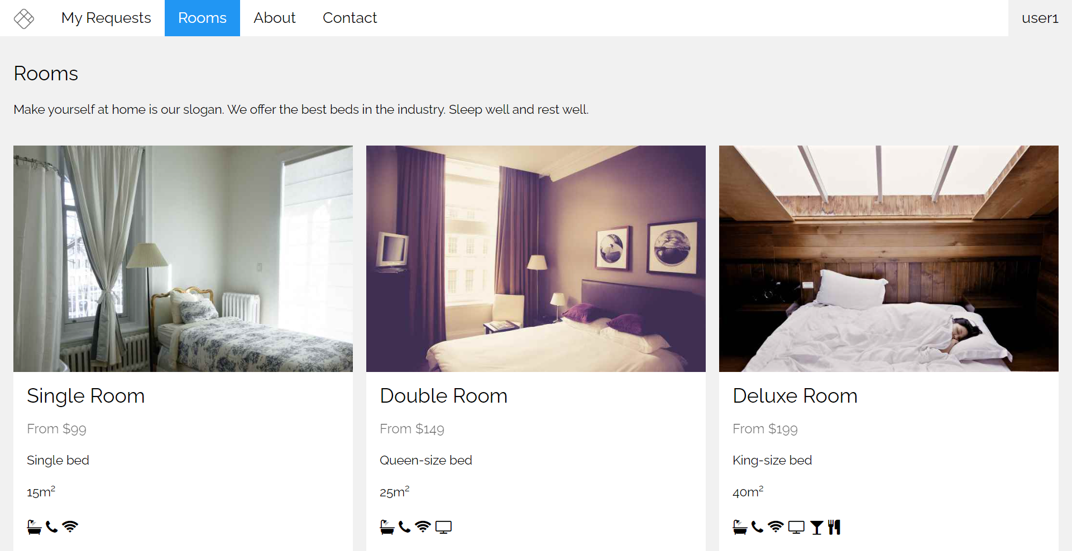
JSP PAGES
User Request
In here User can see the input of the data and check whether the room has been confirmed or not.
Rooms
This page contains the room types.
Luxe Hotel

Slide 6
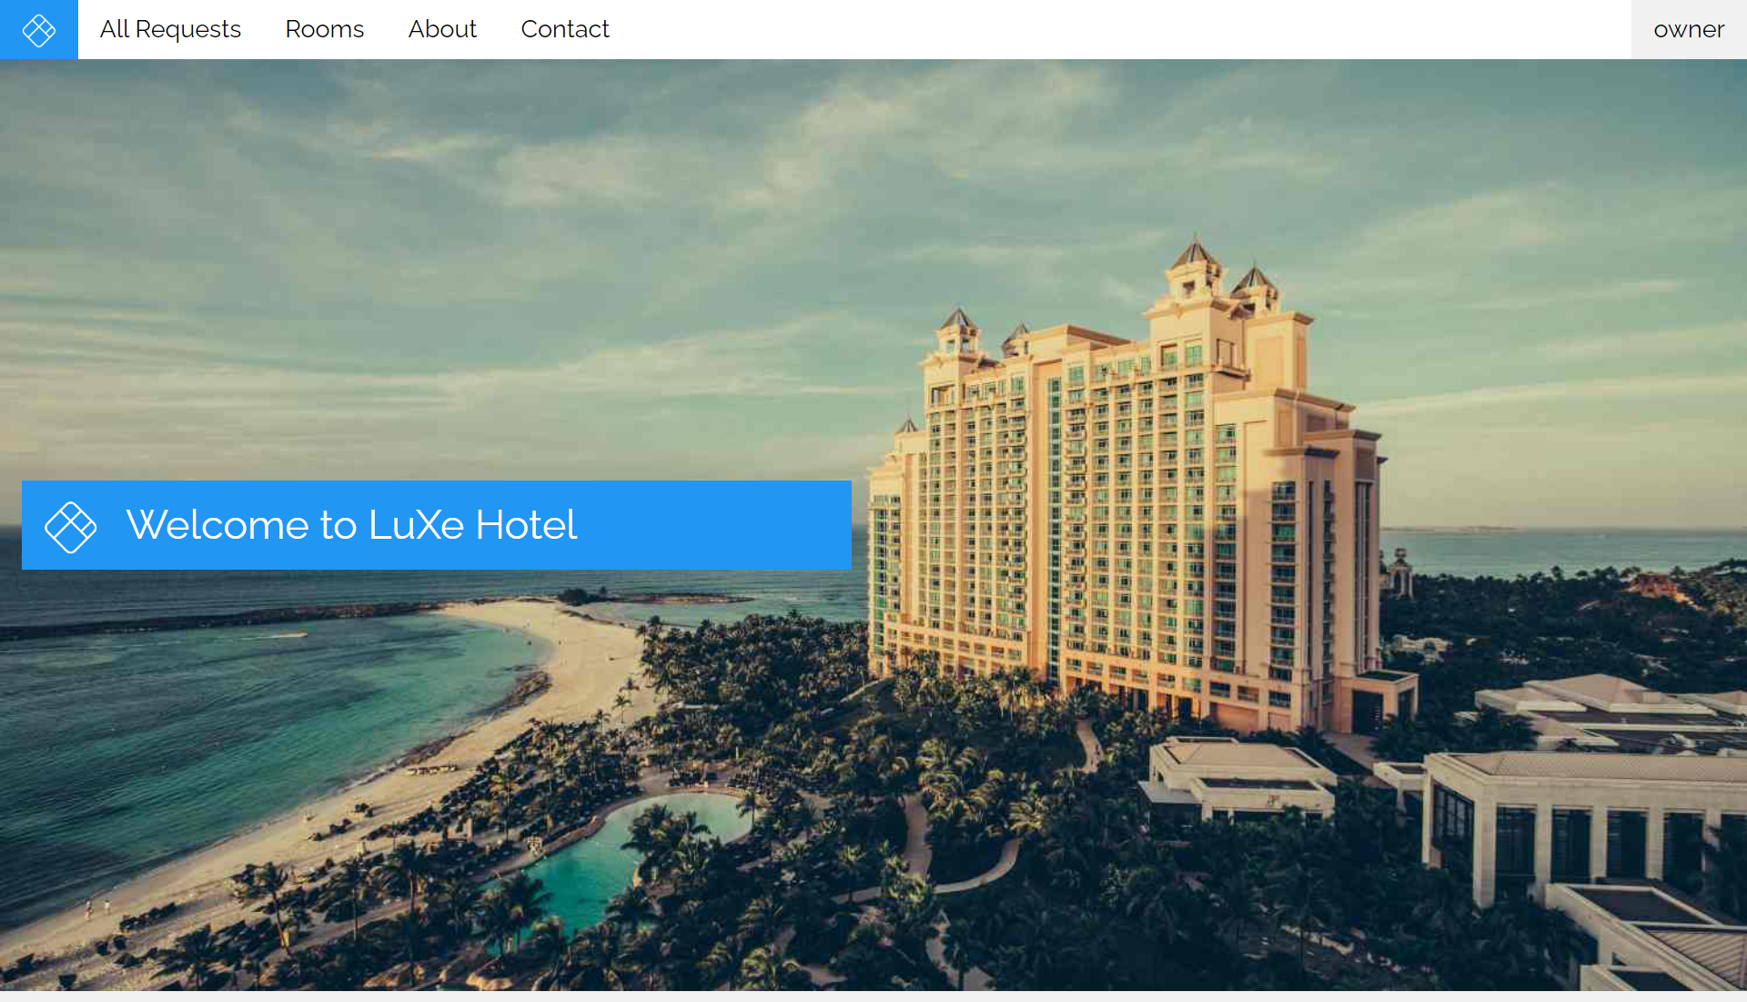
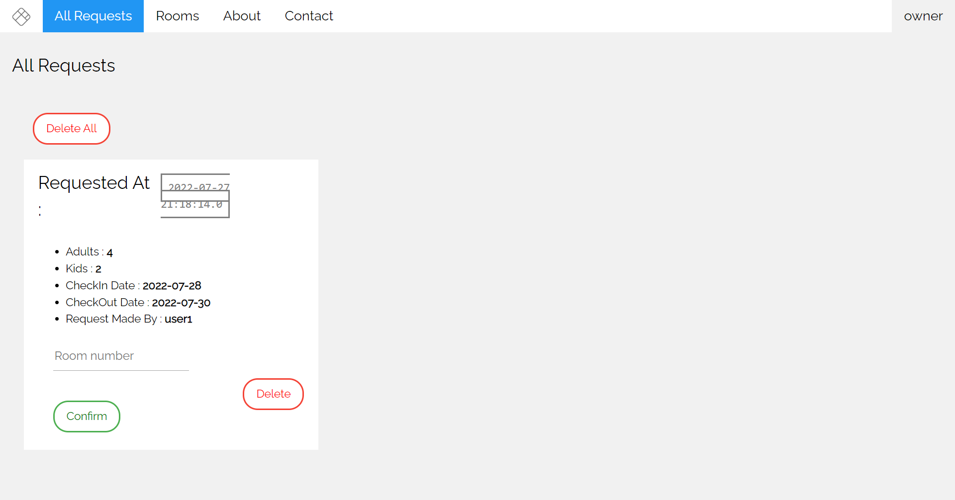
JSP PAGES
Home Employee
This is the home page from the employee section.
Employee Accept
It Contains the data from the owner section, the owner can confirm the reservation from user.
Home
Backgrounds
Banners
Planners
Homework
Tests

Slide 7
Thank You!
Luxe Hotel

